Slide 1

Lecture 0
CAP444 OBJECT ORIENTED PROGRAMMING USING C++
Lecture #0
The kick start session

Slide 2
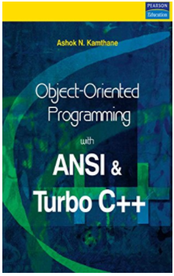
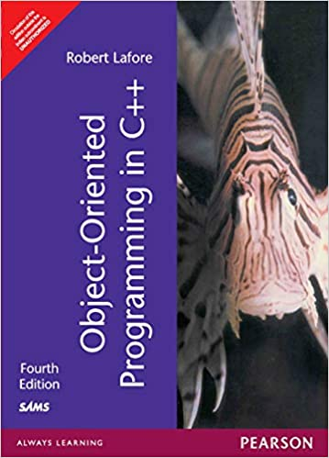
Course details
LTP – 3 0 0 [Three lectures/week]
Text Book
OBJECT ORIENTED PROGRAMMING WITH ANSI & TRUBO C++ by ASHOK N. KAMTHANE, PERASON EDUCATION
Reference Books:
Object Oriented Programming In C++
By Robert Lafore, Galgotia Publications

Slide 3
Course Assessment Model
Marks break up
Attendance 5
Continuous Assessment(2 out of 3) 25
MTT 20
ETT 50
Total 100

Slide 4
Course Outcomes:
CO1 :: define the various concepts of object oriented programming
CO2 :: understand the working with files and streams
CO3 :: practice the generic programming to increase the efficiency of code
CO4 :: analyze the unexpected situations and manage them using exception handling mechanism

Slide 5
Programme Outcomes
1. Computational Knowledge: Apply knowledge of computing fundamentals, computing specialisation, mathematics, and domain knowledge appropriate for the computing specialisation to the abstraction and conceptualisation of computing models from defined problems and requirements.
2. Problem Analysis: Identify, formulate, research literature, and solve complex computing problems reaching substantiated conclusions using fundamental principles of mathematics, computing sciences, and relevant domain disciplines.
3. Design /Development of Solutions: Design and evaluate solutions for complex computing problems, and design and evaluate systems, components, or processes that meet specified needs with appropriate consideration for public health and safety, cultural, societal, and environmental considerations.

Slide 6
Programme Outcomes
4. Conduct investigations of complex Computing problems: Use research-based knowledge and research methods including design of experiments, analysis and interpretation of data, and synthesis of the information to provide valid conclusions.
5. Modern Tool Usage: Create, select, adapt and apply appropriate techniques, resources, and modern computing tools to complex computing activities, with an understanding of the limitations.
6. Professionl Ethics: Understand and commit to professional ethics and cyber regulations, responsibilities, and norms of professional computing practices.
7. Life-long Learning: Recognise the need, and have the ability, to engage in independent learning for continual development as a computing professional.

Slide 7
Programme Outcomes
8. Project management and finance: Demonstrate knowledge and understanding of the computing and management principles and apply these to one ’s own work, as a member and leader in a team, to manage projects and in multidisciplinary environments.
9. Communication Efficacy: Communicate effectively with the computing community, and with society at large, about complex computing activities by being able to comprehend and write effective reports, design documentation, make effective presentations, and give and understand clear instructions.
10. Societal and Environmental Concern: Understand and assess societal, environmental, health, safety, legal, and cultural issues within local and global contexts, and the consequential responsibilities relevant to professional computing practices.
11. Individual and Team Work: Function effectively as an individual and as a member or leader in diverse teams and in multidisciplinary environments.
12. Innovation and Entrepreneurship Identify a timely opportunity and using innovation to pursue that opportunity to create value and wealth for the betterment of the individual and society at large.

Slide 8
Mapping of POs with COs
 |  | CO1 | CO2 | CO3 | CO4
 | PO1 | 3 | 3 | 3 | 3
 | PO2 |  |  |  | 3
 | PO3 | 2 | 2 | 3 | 3
 | PO4
 | PO5 | 2 | 2 | 2 | 2
 | PO6 | 1 | 1 | 1 | 1
 | PO7 | 3 | 1 | 1 | 1
 | PO8
 | PO9
 | PO10
 | PO11
 | PO12

Slide 9
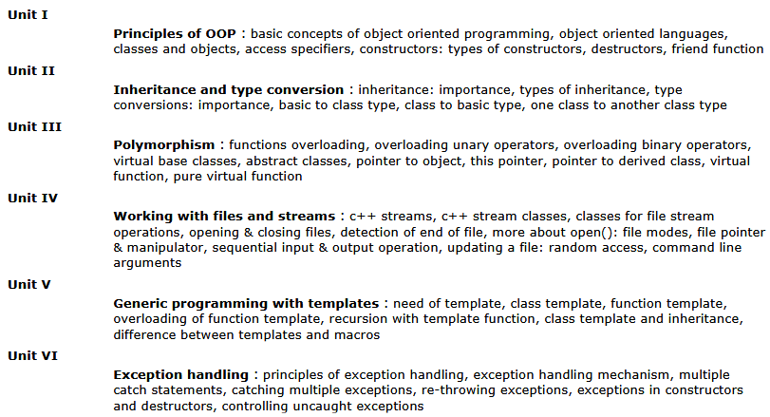
Course Content

Slide 10

The hitch…
The three BURNING questions in mind…
Why are we learning C++ language?
What would we do with it?
What will be the course outcome?

Slide 11

Let us re-invent ourselves
To begin with basics…
Let us go to basics.
Let us begin from toddling to learn to walk
Get ready to be childish….

Slide 12
Daily routine
Let us look around our daily routine…
Let us see where all we do programming everyday
Simple things we do to start the day

Slide 13

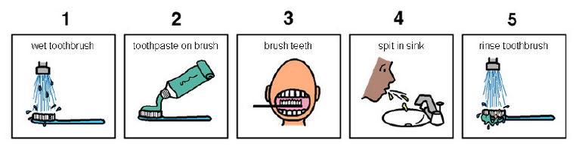
So there is ONE program you know which is there in you…

Slide 14
Daily routine
Start
There is a set procedure
Each step is defined
The occurrence is ordered
Jump is NOT permitted
A step cannot be skipped
Pick Brush
Rinse Brush
Apply Paste
Brush
Rinse Mouth
Rinse Brush
Stop

Slide 15


Daily routine
Let us explore more as the day goes by…
Going for a morning 0900 AM Class
Going for a movie at 0900 AM
It is all about WHICH program is loaded WHEN

Slide 16

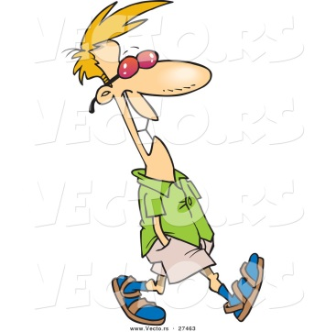
Daily routine
The flow changes
Start
Go!!!
Where
To
Go?
Class
Movie
Stop
Stop

Slide 17

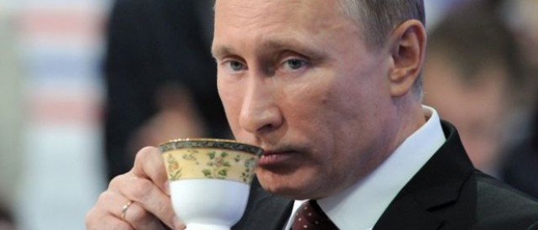




Daily routine
Yet another example but more complex
Vision
Sensor
Sipping TEA
Smell
Sensor
Radiation
Sensor
If all sensors
SIP
If even one is
Touch
Sensor
WAIT!!!

Slide 18




So what does this mean?
Take ANY activity of the day…
It will have a set procedure
It has to be done in a designated way
If not done the specified way will yield wrong results.
Success in doing it depends on how closer one is to the prescribed method.
This clearly shows that everything has a
Logic

Slide 19

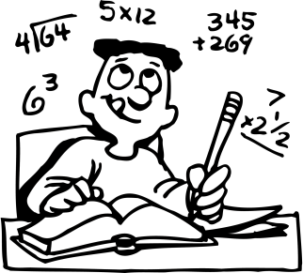
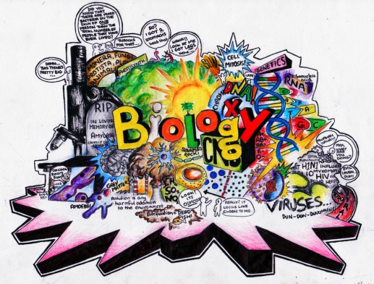





Logic, logic and logic
Logic

Slide 20
What next?
If there is logic in anything and everything
There has to be ways to represent logic
There has to be modes to modify and re-represent logic.
There should be methodology to implement and re-design logic.
And for all this…

Slide 21


What next?
There has to be logic machine to assimilate, understand, solve, store, retrieve and represent logic
There has to be a LANGUAGE to communicate with the logic machine
Otherwise….

Slide 22



Diving deeper…
How do I get A+ grade in CAP444?

Slide 23


Diving deeper…
How do I get A+ grade in CAP444?
If marks are greater than or equal to 85.
A program written in C++ language with LOGIC

Slide 24
The course contents
Principles of OOP's
Operator Overloading and Type Conversions
Run-time Polymorphism and Virtual Functions
Working with Files and Streams
Generic Programming with Templates
Exception Handling

Slide 25
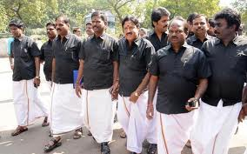


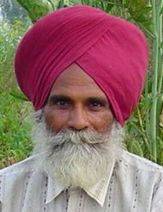

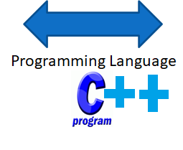
What do we need to know?
Unit 1
Tamil
Punjabi
Need of Language :: Introduction to programming Language

Slide 26
What do we need to know?
Unit 1
Principles of OOP's and C++ Basics
How to do calculations
Area = Length * Breadth
Area = 12 * 5
Area = 10 * 4
Area = 7.6 * 3.7
3.7
4
7.6
5
10
12
Performing Calculations in C++ :: Variables and operators in C

Slide 27

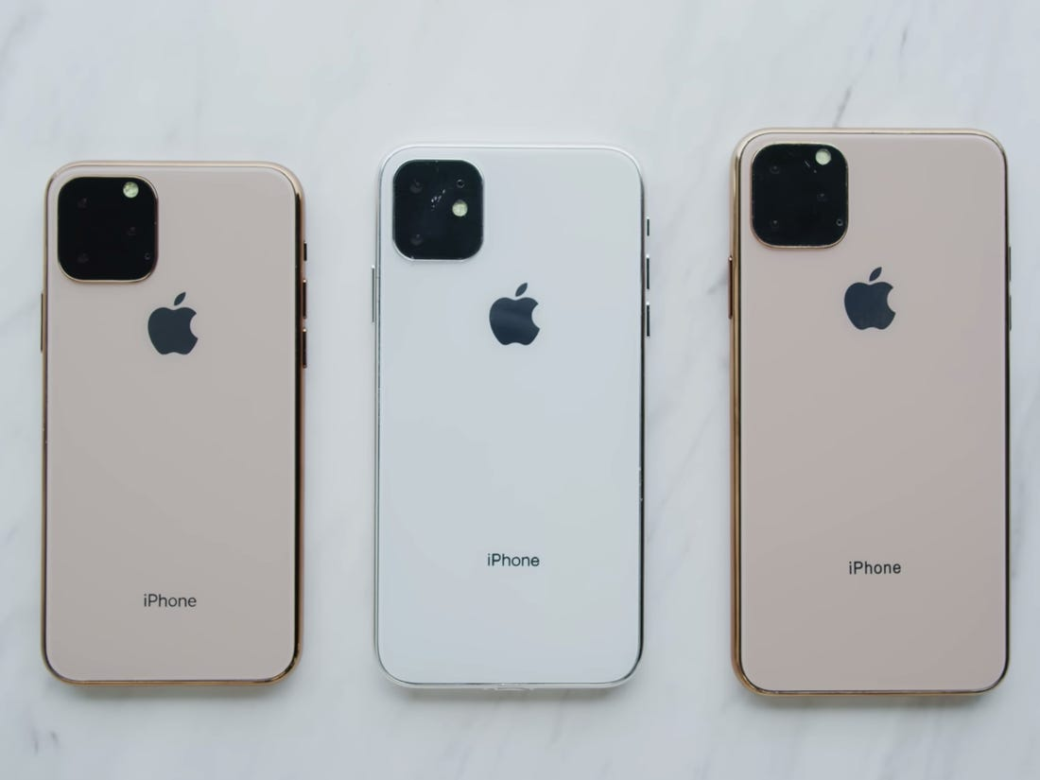
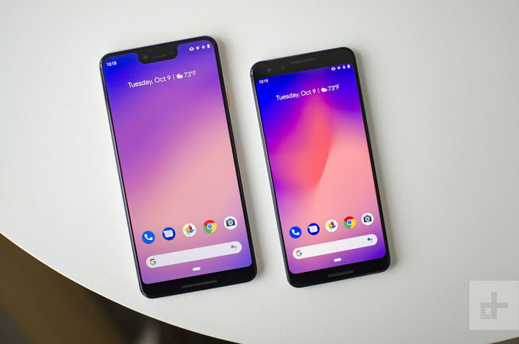
What do we need to know?
Unit 1
Classes and Objects
Mobile
Symbian
(Keypad
Phone)
Android
phone
i-phone

Slide 28

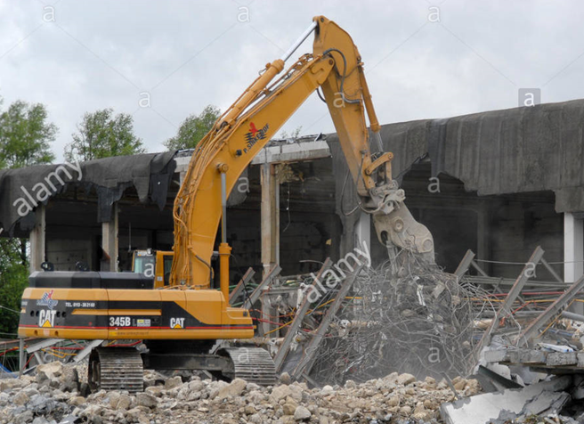
What do we need to know?
Unit 1
Constructors and Destructors

Slide 29



What do we need to know?
Unit 1
Inheritance and its types
father
mother
child

Slide 30

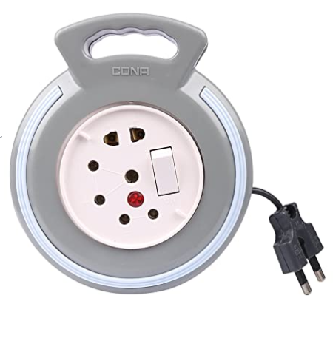
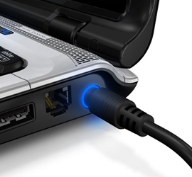
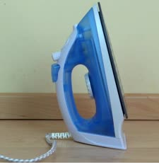
What do we need to know?
Unit 2
Operator Overloading and Type Conversions
One socket board→ multiple work
Ice to water

Slide 31
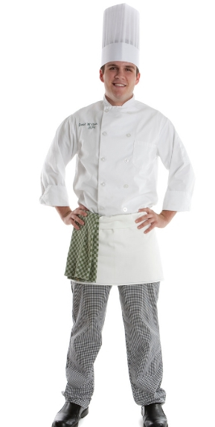
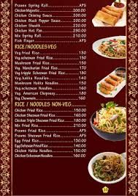

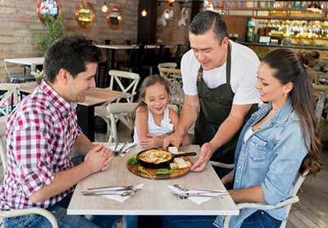
What do we need to know?
Run-time Polymorphism and Virtual Functions
Unit 3
Preparing food
according to hotel menu
During competition preparing food
(Run-time)
Compile time)

Slide 32



What do we need to know?
Unit 4
Working with Files and Streams

Slide 33
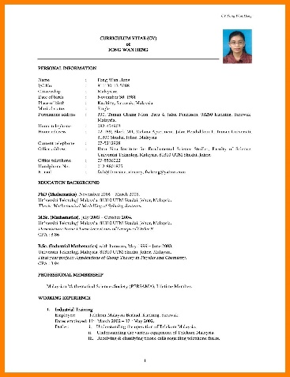


What do we need to know?
Unit 5
Generic Programming with Templates
Resume Format
interview

Slide 34

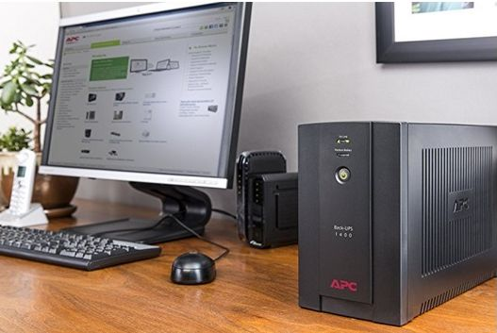

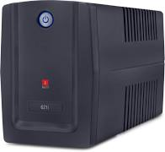
What do we need to know?
Unit 6
Exception Handling

Slide 35
Acknowledgements
The Khan Academy
EdX
Coursera
Cplusplus.com
www.cppforschool.com
Learncpp.com
And Above all…
Common Sense

Slide 36

Next :Principles of OOP's

